Slide 1
Erasmus+

Slide 2
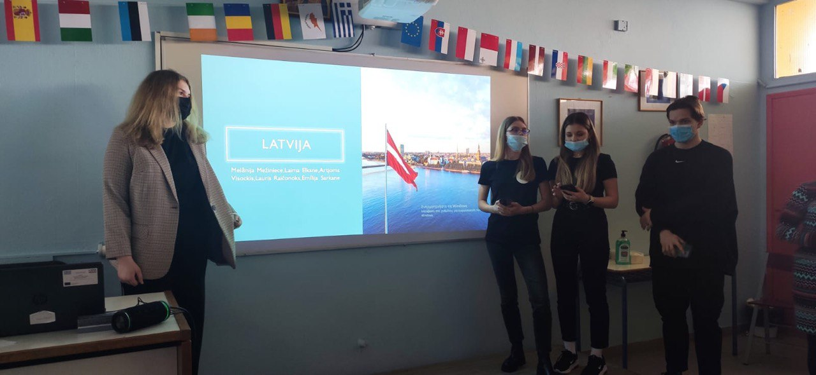
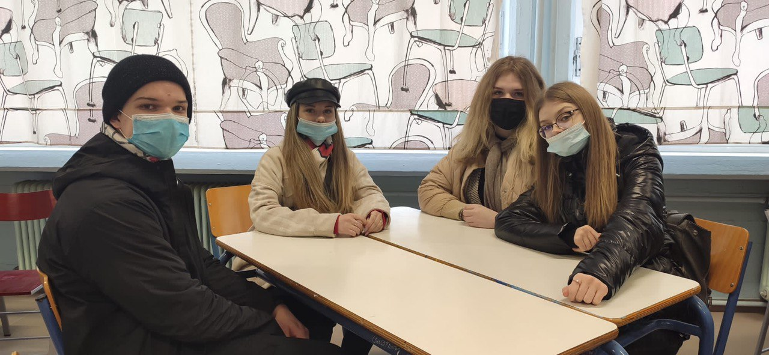
Emīlija Sarkane
Laima Elksne
Melānija Mežiniece
Lauris Raičonaks

Slide 3
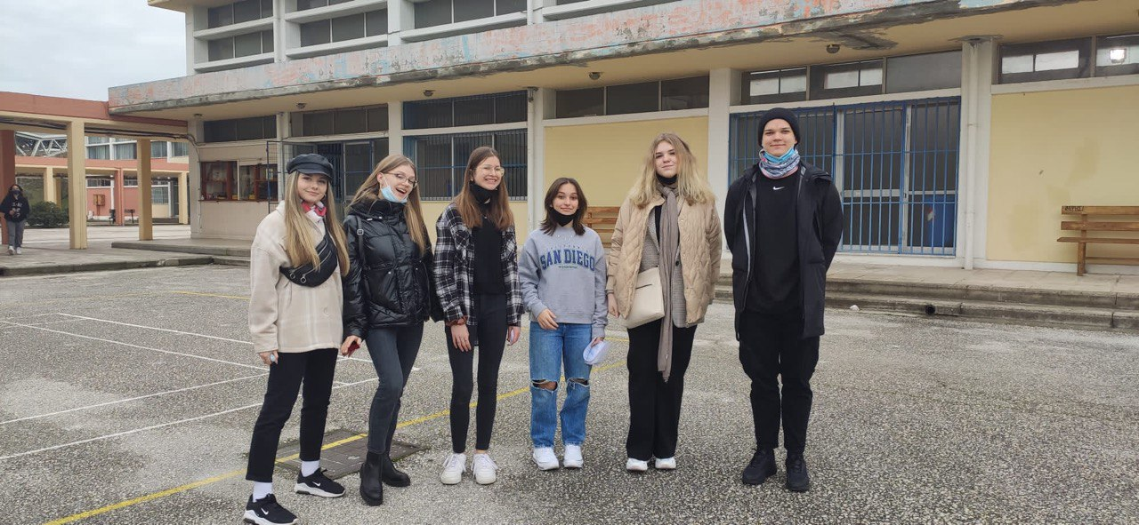
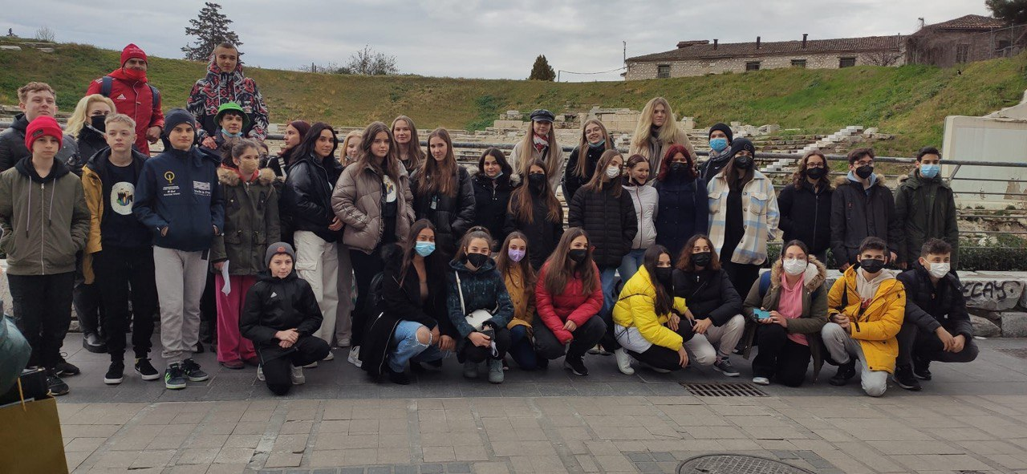
Greece, Larissa

Slide 4
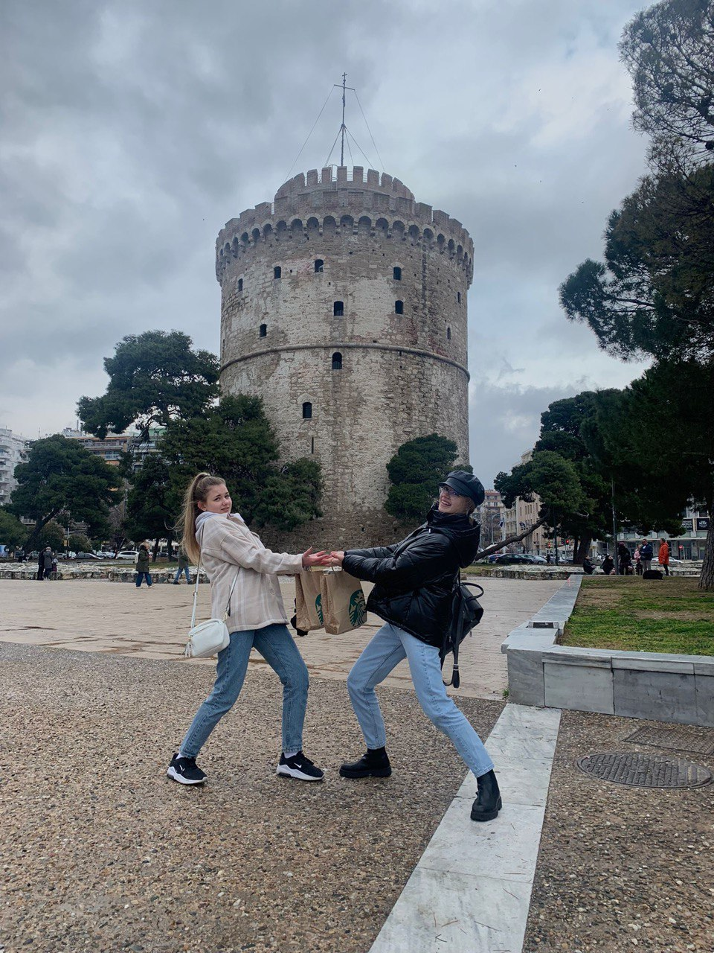
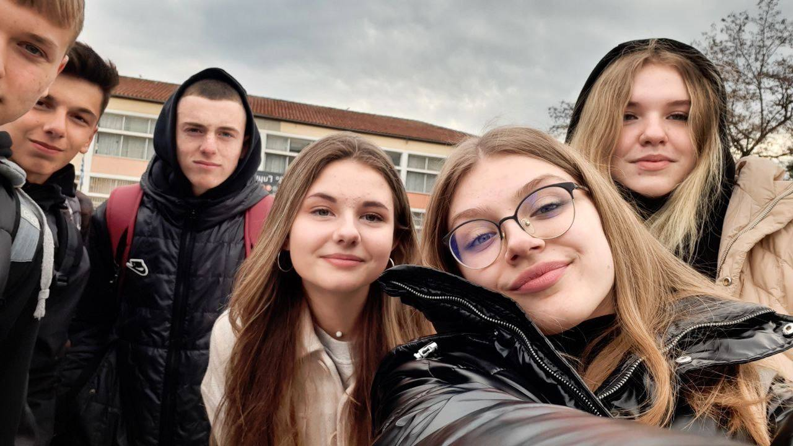
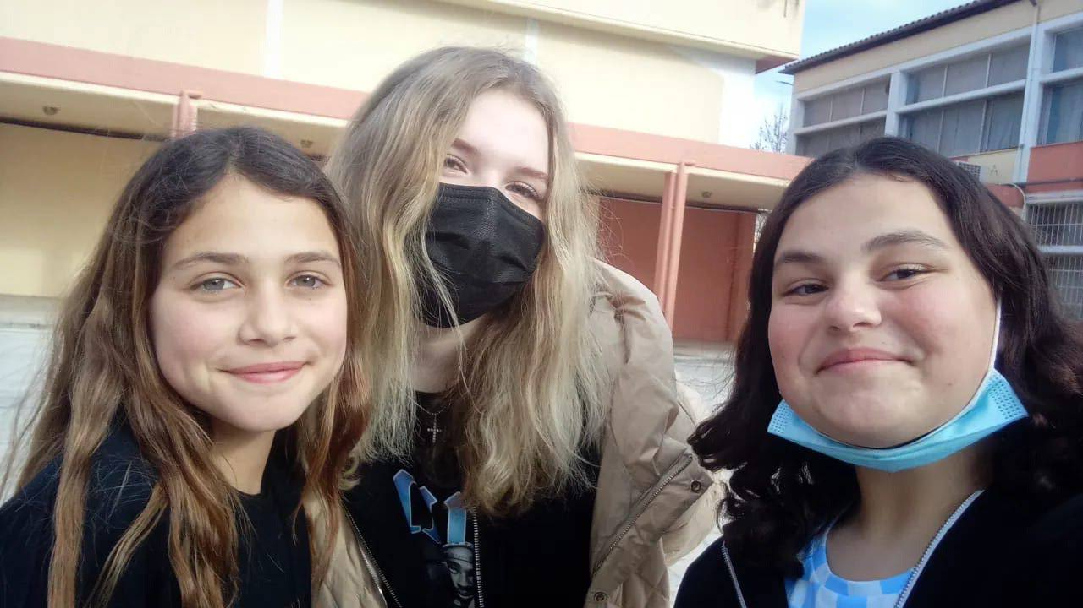
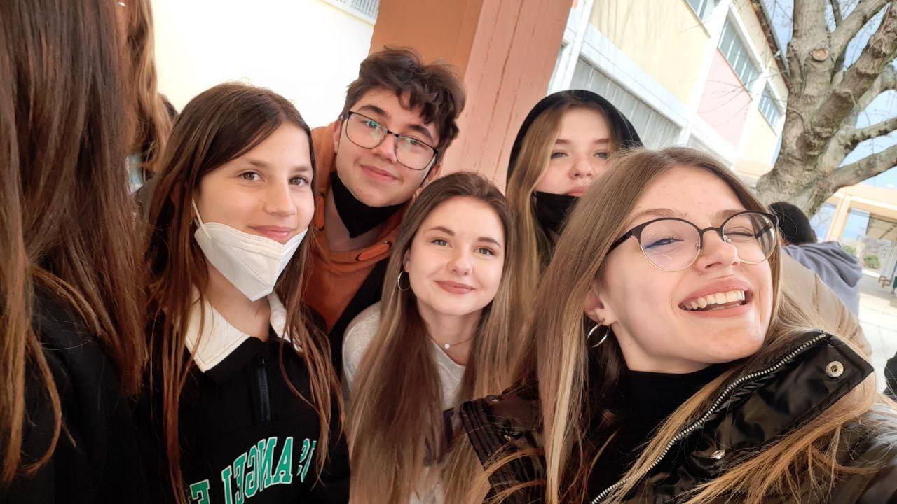
What best describes Larissa and it’s people?
Beautiful
Unique
Inexpensive
Out-going
Lovely

Slide 5
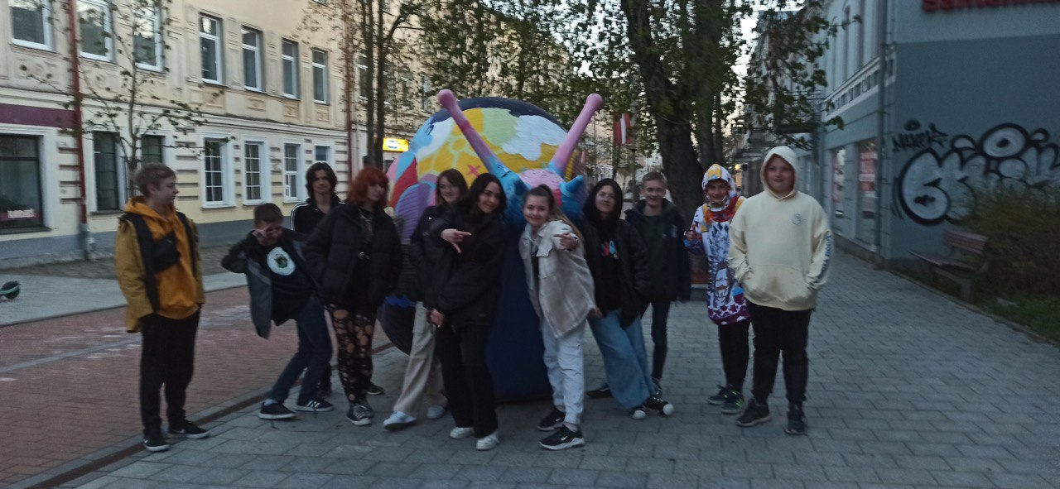
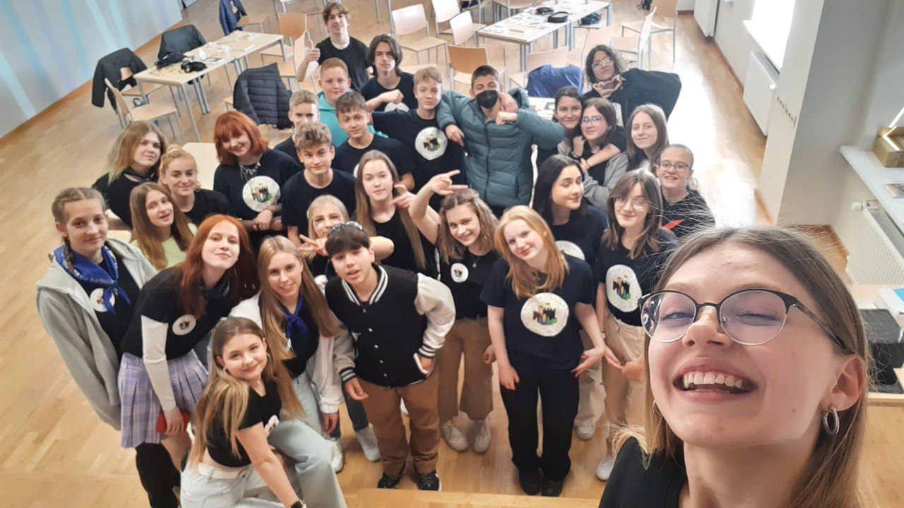
“A picture is worth a thousand words, but a memory is priceless.”

Slide 6
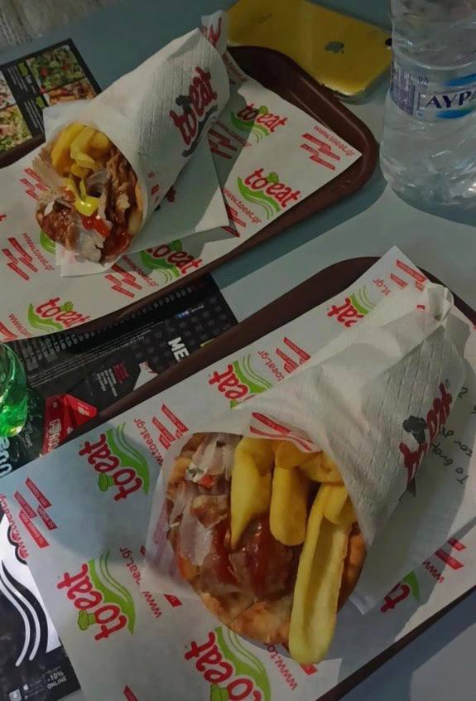
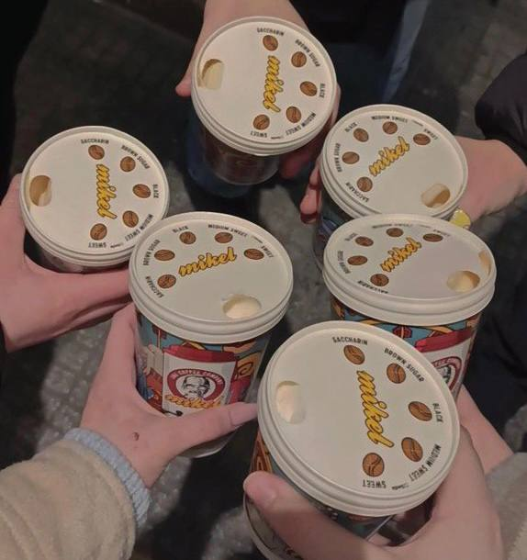
A tourist would never imagine how out-going, friendly, smiley and extraverted greek people are. They are proud of their cutlture, foods, sports and their country.
Tourists would think, that Greece would be very crowded and not taken care of, but it’s completely the opposite.

Slide 7
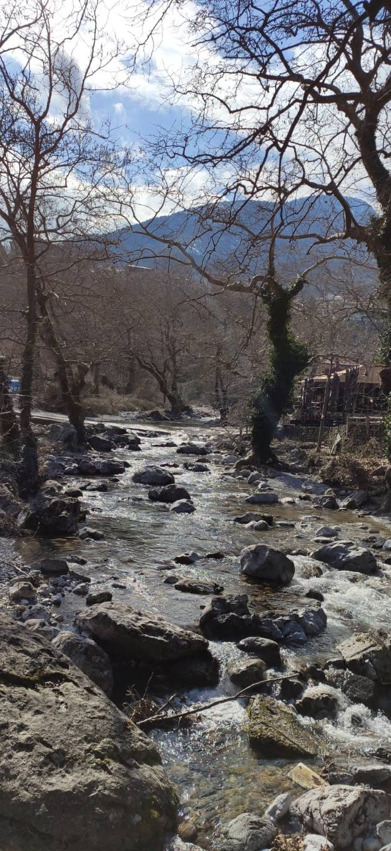
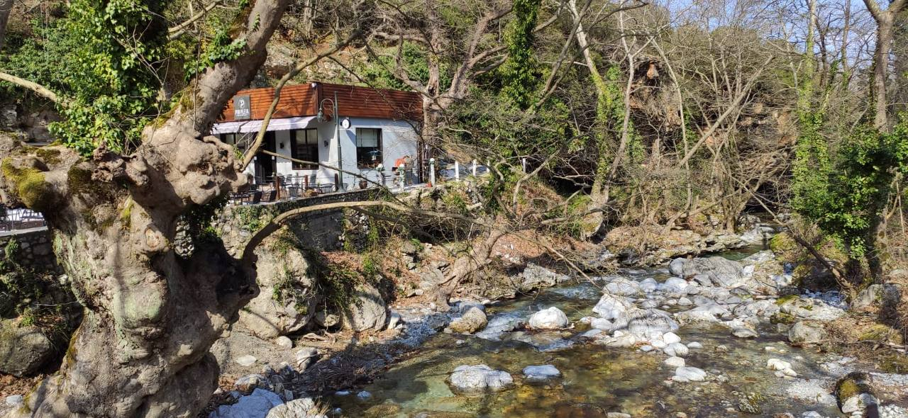

Slide 8
Students who are open-minded, friendly and out-going should participate in projects because they will get unforgettable memories. To get the best memories out of any project you have to socialize, not only with your friends but also with students who are from different countries.

Slide 9
How do Erasmus+ projects differ from the everyday learning process?
You have a chance to socialize with students from other countries.
Explore a completely new school and get to know their everyday learning processes.
You learn about new places, culture, foods and the country in general.

Slide 10
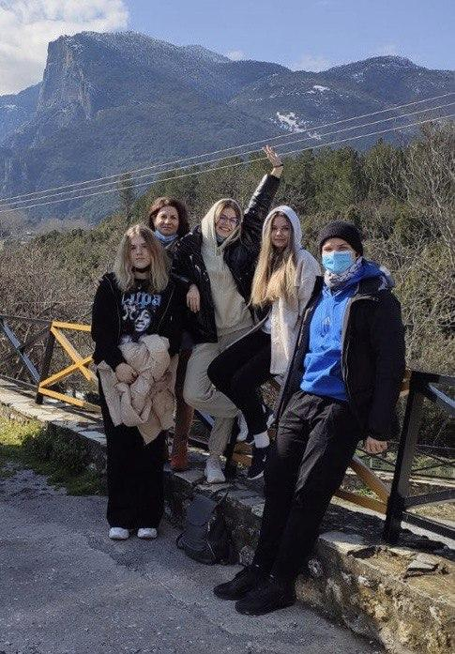
During the mobility we explored Larissa the most.
We also made sure we talked and became friends with everyone.
We loved getting to know them and the place they are from.

